Slide 1


Privacy
School of Business, Law and Entrepreneurship
Online Learning Materiel: Week 4 Presentation 1

Slide 2

This session’s roadmap
What we will be covering.
Set the scene for exploring the topic of Privacy
What is Privacy? The 2 BIG questions.
Why does Privacy matter?
Technology and Privacy
The Cost of Privacy

Slide 3
This session’s objectives.
Objectives of this session.
Understand the characteristics of Privacy
Understand why Privacy is important to individuals & organisations
Explore the context of Privacy & Technology
Identify and become familiar with key pieces of Privacy legislation
Extend Privacy into Surveillance and explore Uberveillance
THINK & REFLECT upon Privacy issues as a current/future ICT Professional
Identify areas for further exploration in your own time
Be more knowledgeable at the end of the session

Slide 4
This session’s ULO’s.
1. Develop and present a resolved project outcome which synthesises an understanding of ethical and socio-technical challenges faced by an ICT professional
2. Evaluate the role of standards, codes of conduct and legislative/regulatory obligations on the level of professionalism of the ICT industry
3. Review the roles and responsibilities of ICT professionals in organisations and society from a range of perspectives such as work-life balance, mentoring and life-long learning
What you need to do with this recorded presentation.
Watch, reflect and take your own notes
Jot down any queries you may have on the concepts ready for the weekly LIVE Catchup.
How long will this task take.
This task will take approx. 45 minutes to complete this session. There is a Part 2 which will take ~ 15 minutes.

Slide 5
Privacy

Slide 6

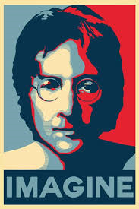

Setting the scene
Which famous musician’s FBI record is this?

Slide 7

Privacy / Setting the scene.
A recent investigative series by Simon Elvery from ABC News’ Interactive Digital Storytelling Unit uncovers some of the challenges.
He recorded every time his phone was asked for data over a week –
It turned out to be more than 300,000 times.
On a single night Simon’s phone made contact with 46 domains!

Slide 8
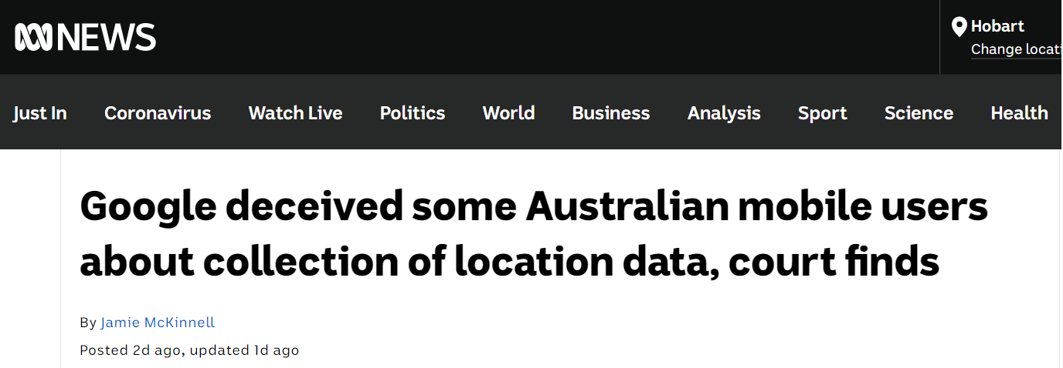
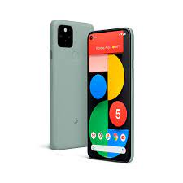
Privacy / In the news.
Google Pixel phone
Impression that selecting ‘Turn Location History Off’ would stop the tracking. It didn’t. If you let other Apps run such as Google Maps, your location data was recorded.

Slide 9
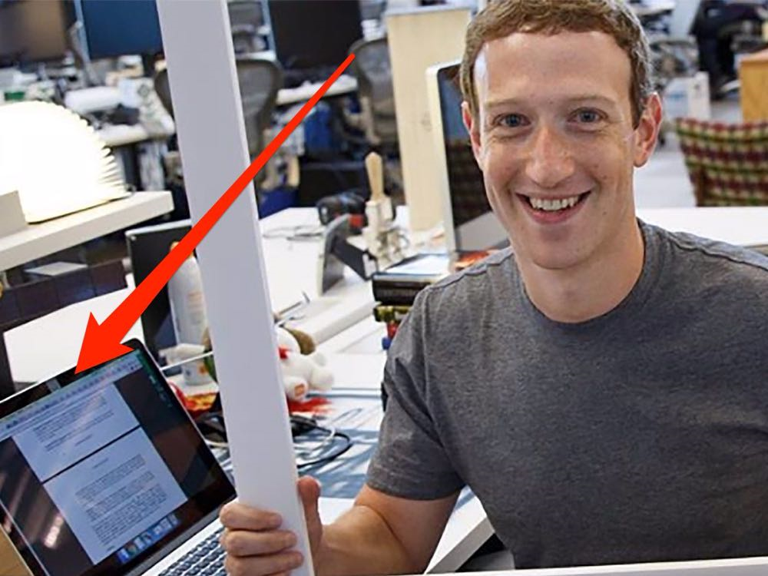
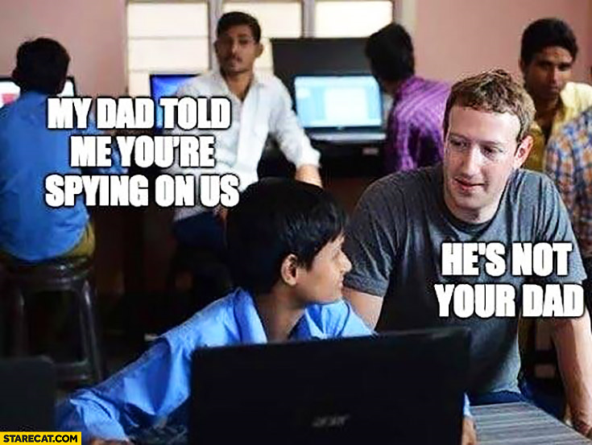
Can you join in the ‘conversation circle’ on Privacy?
What is your current level of professionalism on the topic of Privacy?
“Those Metadata laws are crazy! What do you think?”
“How about that Cambridge Analytica thing!”
“Did you hear the latest issue with FB and the GDPR?”

Slide 10
Can you name the Global Privacy Gurus?
Professor Roger Clarke (Xamax https://www.rogerclarke.com/)
Dr Ann Cavoukian, Information and Privacy Commissioner for the Canadian province of Ontario, Privacy by Design (PbD)
Professor Katina Michael (Arizona State University)
Dr MG Michael (University of Wollongong)
Dr Jennifer King (Stanford)
Giovanni Buttarelli, European Data Protection Supervisor
Professor Evan Selinger (Rochester Institute of Technology) @EvanSelinger

Slide 11
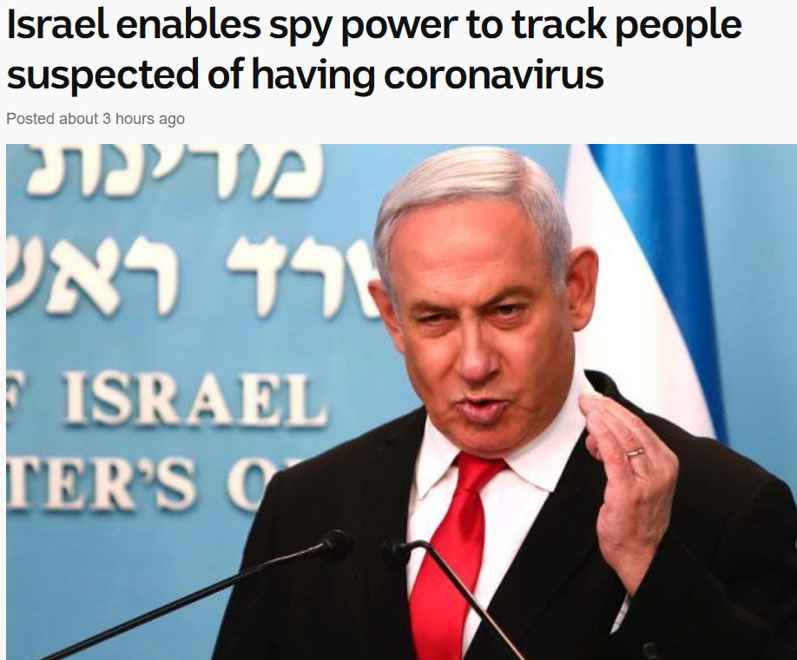
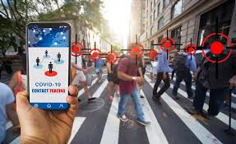
Privacy in the age of COVID-19.
Europeans are closely examining the South Korean model of contact tracing, which involves the use of personal information such as immigration, public transportation and credit-card records in addition to location-tracking GPS data.
While legal safeguards exist in most democracies to protect digital privacy, the danger of the coronavirus could quickly compel policymakers to override them. On Friday, the European Union's Data Protection Authority cautiously endorsed putting privacy on pause during the public health emergency.
Notes:
https://www.abc.net.au/news/2020-03-18/israel-enables-spy-services-to-track-coronavirus-patients/12066256

Slide 12
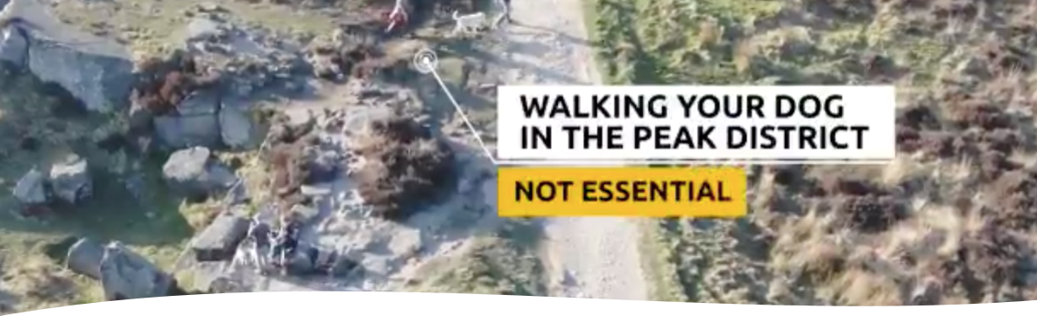
Privacy in the age of COVID-19 /2.

Slide 13
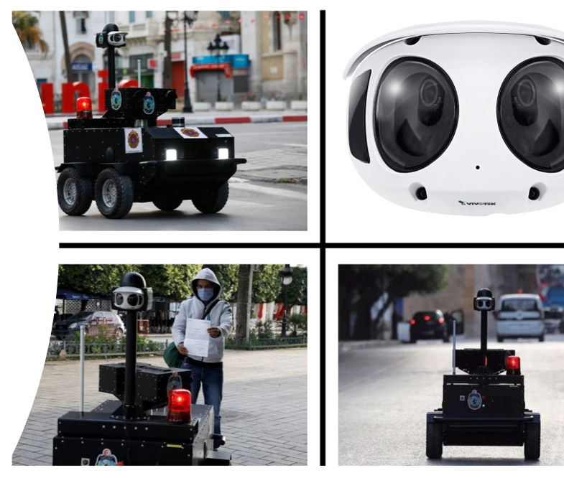
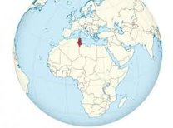
Privacy in the age of COVID-19 /3.
P GUARD, Tunisia

Slide 14

What does privacy mean to you?

Slide 15




Search the Web for a recent news article on Privacy.
What was the topic?
Who were the stakeholders?
What main ethical dilemma was evident?
Were there any legal implications involved?
How would the topic of the article impact you personally or professionally?

Slide 16

What does privacy mean to you?
Freedom from interference or intrusion
Freedom from surveillance
The right to be left alone
Our own space
Something else?
Privacy is the interest that individuals have in sustaining a 'personal space', free from interference by other people and organisations (Clarke 2019)

Slide 17



The 2 BIG questions about privacy (Johnson 2001).
What is privacy and why is privacy valuable?
We often think about privacy in different ways, for example:
Physical privacy - such as bag searching, use of DNA
Information privacy - the way in which government agencies or organisations handle personal information such as age, address, physical or mental health records

Slide 18

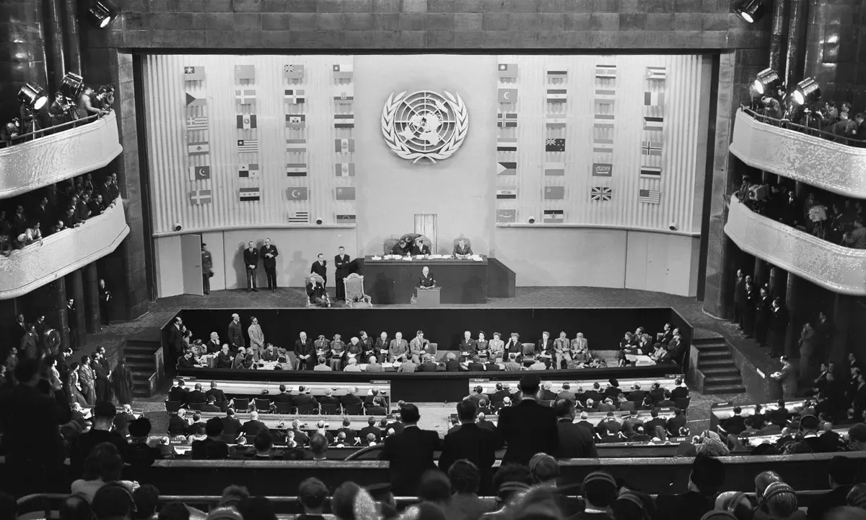
Privacy is a Human Right.
Article 12 of the United Nations Universal Declaration of Human Rights states:
“No one shall be subjected to arbitrary interference with his privacy, family, home or correspondence, nor to attacks upon his honour and reputation. Everyone has the right to the protection of the law against such interference or attacks”

Slide 19
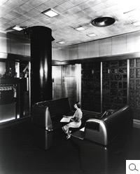
Privacy is a Human Right /2.
Are we faced with greater Privacy issues now compared to 1948?
Consider the development of technology since 1948
What’s the correlation between ‘new’ tech and current privacy issues???
IBMs Selective Sequence Electronic Calculator (SSEC) 1948
Geoff Jones
https://hbswk.hbs.edu/item/lessons-from-ibm-in-nazi-germany

Slide 20

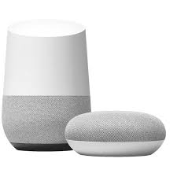
Technology’s impact on privacy.
Data records / Databases
Surveillance / Profiling
Networks / Internet
Mobile devices
IoT (Google Home/Amazon Alexa)
Wearables (Fit-Bit)
Social media
E-Government
Other?

Slide 21
Why privacy matters.
New technologies are raising increasingly connected and complex interactions – presenting individuals and organisations with new privacy risks
Once it’s gone, it’s almost impossible to get it back
Its all about the protection of personal data
What do you regard as information which NO-ONE should have access to?
Political affiliation
Data that can identify you
Your sexual orientation
Your academic record
Your health record
Consider how privacy manifests itself in your lives?

Slide 22
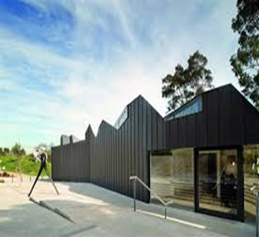
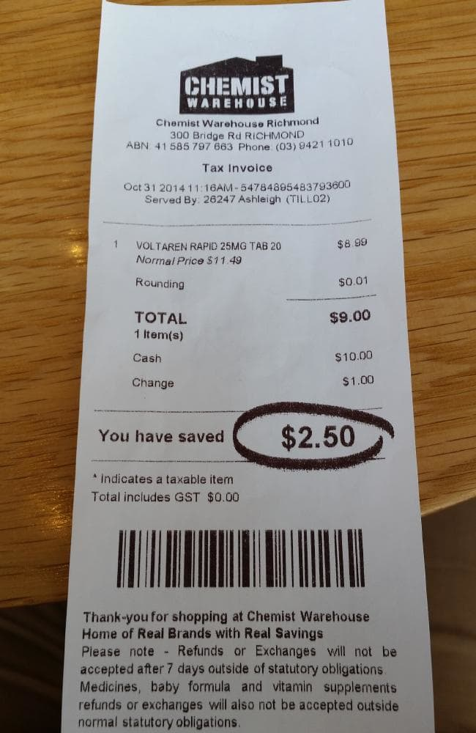


Served by {Privacy Issue?}….

Slide 23
Shallow Dive: Is the cost of privacy too high?
Can you really...
not to use credit cards (using only cash) so no information is gathered about your buying habits.
not to subscribe to magazines so no company ever identifies your interests and sells your name to marketers.
not to buy a home until you have saved enough to pay for it in cash (so that no-one has details of your borrowings).
pay for all your medical care yourself to avoid records being created by a health insurance company.

Slide 24
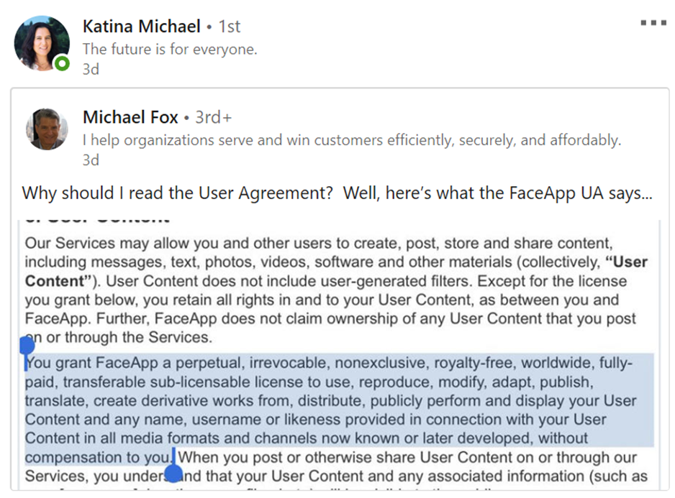

Slide 25


